Slide 1


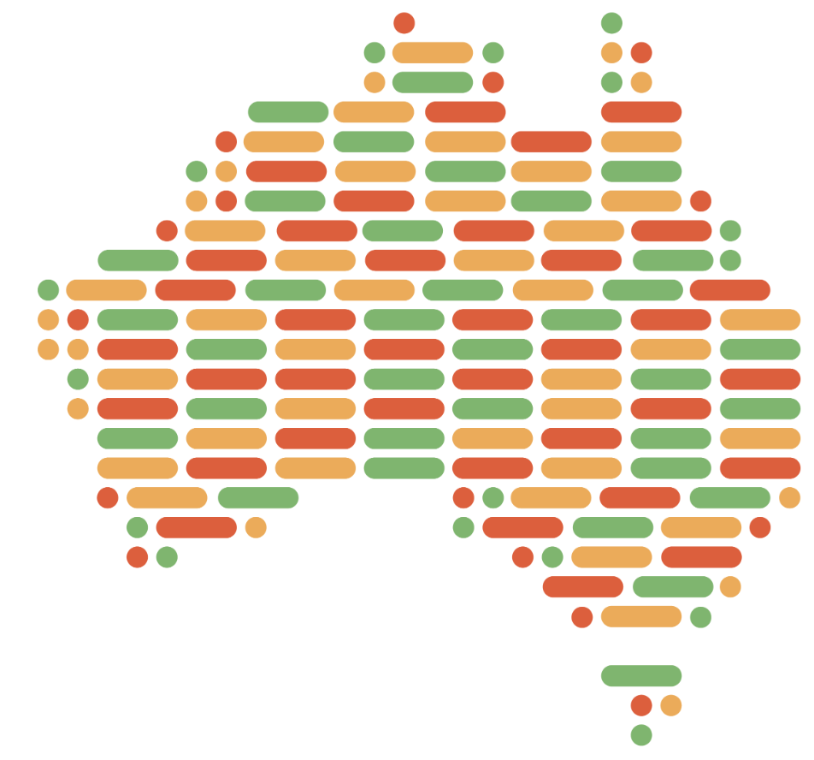




Kidney-Genetics – a reproducible and curated database of kidney disease genes
Nina Rank¹, Constantin Wolff¹, Jan Halbritter¹, Bernt Popp²
¹ Klinik m. S. Nephrologie und internistische Intensivmedizin, Charité - Universitätsmedizin Berlin
² Berlin Institute of Health, Charité - Universitätsmedizin Berlin, Center of Functional Genomics
Objective
Genetic insights increasingly influence the understanding and treatment of kidney diseases. Hundreds of genes associated with monogenic kidney disease have been identified. However, the lack of a unified and standardized database of genes assigned with kidney diseases has led to diagnostic blind spots and comparability issues among current studies of kidney genetics. To address this gap, we created Kidney-Genetics, a regularly updated, automated and publicly accessible database of all relevant genes associated with kidney disease: https://github.com/halbritter-lab/kidney-genetics
Methods and Results
We compiled kidney disease-associated gene information from five sources (PanelApp, Literature, Diagnostic panels, HPO, and PubTator) and created a standardized evidence-scoring system (0 – 5) to distinguish highly confirmed disease genes from candidate genes. Each passing of an evidence filter criterion contributed to 1 point each in the final evidence count.
PanelApp
Literature
Diagnostic Panels
HPO
PubTator
16 published kidney
gene lists
Claus et al., AJMG, 2022
Gharavi et al., Ann Intern Med, 2018
Bleyer et al., Am J Nephrol, 2022
…
10 diagnostic panels
Centogene Nephrology
Mayocliniclabs Renal Genetics
Blueprintgenetics Nephrology
…
HP:0010935
“Abnormality of the upper urinary tract“
in
OMIN or Orphanet
“kidney disease” or “renal disease”
AND
gene or syndrome
AND
variant or mutation
Genomics
England
PanelApp
PanelApp Australia
546
822
911
779
2032
2,906 genes
Evidence Filter
in ≥ 2 gene lists
in ≥ 2 panels
no filter
in ≥ 3 publications
444
491
540
779
713
1454 genes
861
1015 candidate genes
154
177
439 high-evidence genes
135
127
1
2
3
4
5
Evidence Count
Conclusion
Future Objectives
By utilizing Kidney-Genetics, clinicians, geneticists, and researchers can examine genomic data and improve their understanding of the genetic components of diverse kidney diseases. A standardized pipeline and automated system keep the database on the cutting edge of kidney research and diagnostics.
Manual curation of the 439 high-evidence genes
curation available
no curation
ClinGen score
Manual scoring
Curated list of high-evidence genes
Phenotypic grouping

